Slide 1
Observer Design Pattern
The Observer pattern offers a subscription model in which objects subscribe to an event and get notified when the event occurs.
Observer pattern is the cornerstone of event driven programming, including JavaScript.
The Observer pattern facilitates good object-oriented design and promotes loose coupling.
@ShankaragoudaG

Slide 2
Observer Pattern Usage
When building web apps you end up writing many event handlers.
Event handlers are functions that will be notified when a certain event fires. These notifications optionally receive an event argument with details about the event.
The event and event-handler paradigm in JavaScript is the manifestation of the Observer design pattern.

Slide 3
Publication/Subscription Pattern vs Observer Pattern
Observer is a one-to-one relationship, whereas the Publish/Subscribe Pattern is a one-to-many relationship.
In the Observer Pattern, one Observer is subscribed to one Subject. In the Publish/Subscribe Pattern, one Subject can be subscribed to many Observers.
The Observer pattern requires that the observer (or object) wishing to receive topic notifications must subscribe this interest to the object firing the event (the subject).

Slide 4
Continued...
The Publish/Subscribe pattern however uses a topic/event channel which sits between the objects wishing to receive notifications (subscribers) and the object firing the event (the publisher).
The idea of Publish/Subscribe pattern is to avoid dependencies between the subscriber and publisher.
This differs from the Observer pattern as it allows any subscriber implementing an appropriate event handler to register for and receive topic notifications broadcast by the publisher.

Slide 5
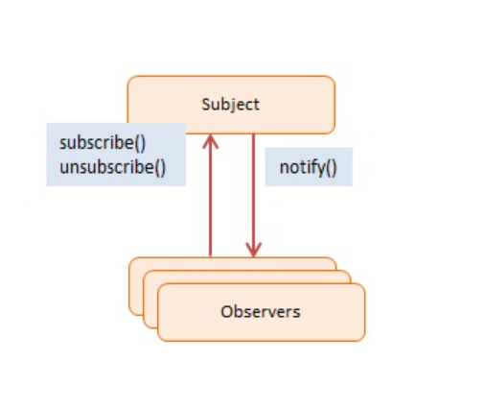
Observer Design Diagram
Subject -- In example code: Click
maintains list of observers. Any number of Observer objects may observe a Subject
implements an interface that lets observer objects subscribe or unsubscribe
sends a notification to its observers when its state changes
Observers -- In example code: clickHandler
has a function signature that can be invoked when Subject changes (i.e. event occurs)

Slide 6
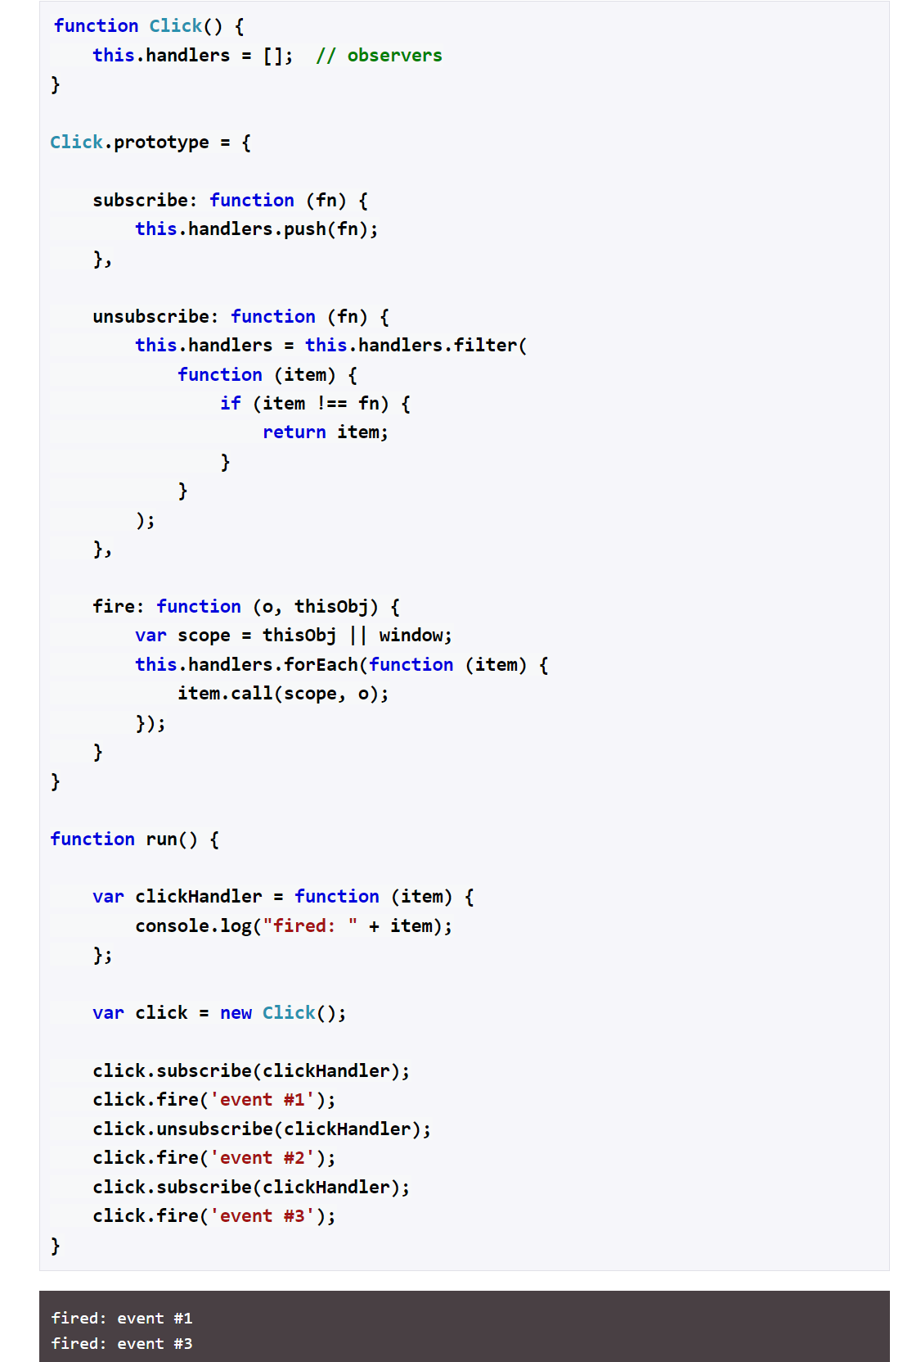
Example
The Click object represents the Subject.
The clickHandler function is the subscribing Observer. This handler subscribes, unsubscribes, and then subscribes itself while events are firing. It gets notified only of events #1 and #3.
The fire method accepts two arguments. The first one has details about the event and the second one is the context, that is, the this value for when the eventhandlers are called. If no context is provided this will be bound to the global object (window).

Slide 7
Useful Resources
https://www.oreilly.com/library/view/learning-javascript-design/9781449334840/ch09s05.html
https://www.dofactory.com/javascript/design-patterns/observer

